Slide 1
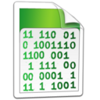



Data Types and Variables
JavaScript Fundamentals
Telerik Software Academy
http://academy.telerik.com

Slide 2

Table of Contents
Data Types
Integer
Floating-Point
Boolean
String
Declaring and Using Variables
Identifiers
Declaring Variables and Assigning Values

Slide 3


Data Types in JavaScript

Slide 4
How Computing Works?
Computers are machines that process data
Data is stored in the computer memory in variables
Variables have name, data type and value
Example of variable definition and assignment in JavaScript:
Variable name
let count = 5;
Variable value

Slide 5

What Is a Data Type?
A data type:
Is a domain of values of similar characteristics
Defines the type of information stored in the computer memory (in a variable)
Examples:
Positive integers: 1, 2, 3, …
Alphabetical characters: a, b, c, …

Slide 6
JavaScript Data Types
JavaScript is weakly typed language
i.e. the type of a variable can be changed
All variables are declared with the keyword var, let, const
Values have types, variables don’t
var count = 5; // variable holds an integer value
count = 'hello'; // the same variable now holds a string
var name = 'Telerik Academy'; // variable holds a string
let mark = 5.25 // mark holds a floating-point number
mark = true; // mark now holds a boolean value const MAX_COUNT = 250;
MAX_COUNT = 0; // error

Slide 7
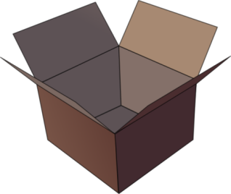

Introducing Variables
p
q
i

Slide 8

What Is a Variable?
A variable is a:
Placeholder of information that can usually be changed at run-time
A piece of computer memory holding some value
Variables allow you to:
Store information
Retrieve the stored information
Manipulate the stored information

Slide 9

Variable Characteristics
A variable has:
Name
Value
Example:
Name: counter
Value: 5
let counter = 5;

Slide 10

Integer Types

Slide 11
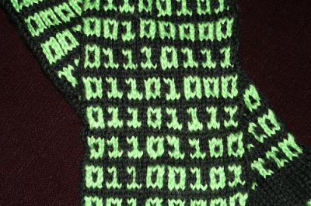
What are Integer Types?
Integer types:
Represent whole numbers
Have range of values, depending on the size of memory used

Slide 12
Integer Types – Example
Integer type can hold numbers from -9007199254740992 to 9007199254740992
The underlying type behind is a floating-point number (IEEE-754)
var studentsCount = 5;
var maxInteger = 9007199254740992;
var minInteger = -9007199254740992;
var a = 5, b = 3;
var sum = a + b; // 8
var div = a / 0; // Infinity

Slide 13

Integer Types
Live Demo

Slide 14

Floating-Point Numbers

Slide 15
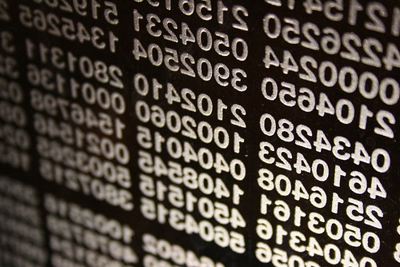
What are Floating-Point Types?
Floating-point types:
Represent real numbers
Have range of values and precision
Can behave abnormally in the calculations

Slide 16
Floating-Point Types
Floating-point size depend on the platform
The browser and the OS
32-bit OS and browser have 32 bits for number, while 64-bit have 64 bits
It is good idea to use up to 32-bit numbers
Will always work on all platforms

Slide 17
Floating-Point Types – Example
The floating-point type can hold numbers from 5e-324 to 1.79e+308
var PI = Math.PI; // 3.141592653589793
var minValue = Number.MIN_VALUE; // 5e-324
var maxValue = Number.MAX_VALUE; // 1.79e+308
var div0 = PI / 0; // Infinity
var divMinus0 = -PI / 0; // -Infinity
var unknown = div0 / divMinus0; // NaN

Slide 18

Abnormalities in the Floating-Point Calculations
Sometimes abnormalities can be observed when using floating-point numbers
Comparing floating-point numbers can not be performed directly with the equals operators (== and ===)
Example:
var a = 0.1;
var b = 0.2;
var sum = 0.3;
var equal = (a+b == sum); // false!!!
console.log('a+b = '+ (a+b) + ', sum = ' +
sum + ', sum == a+b? is ' + equal);

Slide 19

Floating-Point Types
Live Demo

Slide 20
Numbers in JavaScript
All numbers in JavaScript are stored internally as double-precision floating-point numbers
According to the IEEE-754 standard
Can be wrapped as objects of type Number
Example:
var value = 5;
value = 3.14159;
value = new Number(100); // Number { 100 }
value = value + 1; // 101
var biggestNum = Number.MAX_VALUE;

Slide 21
Numbers Conversion
Convert floating-point to integer number
Convert to integer number with rounding
Convert string to integer
var valueDouble = 8.75;
var valueInt = valueDouble | 0; // 8
var valueDouble = 8.75;
var roundedInt = (valueDouble + 0.5) | 0; // 9
var str = '1234';
var i = str | 0 + 1; // 1235

Slide 22
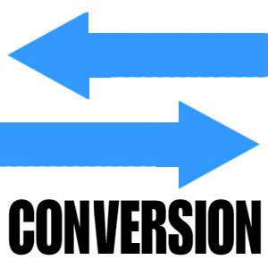
Number Conversion
Live Demo

Slide 23
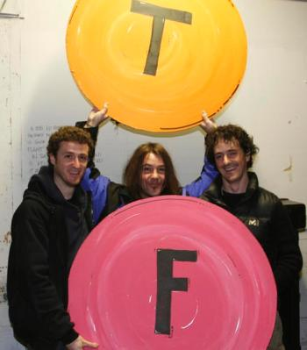

Boolean Type

Slide 24

The Boolean Data Type
The Boolean data type:
Has two possible values:
true and false
Is useful in logical expressions

Slide 25
Boolean Values – Example
Example of boolean variables taking values of true or false:
var a = 1;
var b = 2;
var greaterAB = (a > b);
console.log(greaterAB); // false
var equalA1 = (a == 1);
console.log(equalA1); // true

Slide 26

Boolean Type
Live Demo

Slide 27

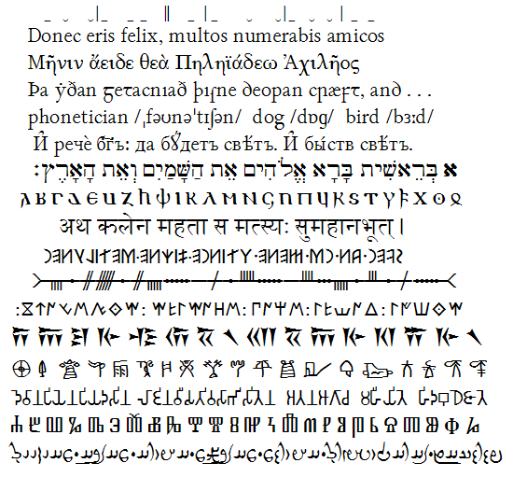
String Type

Slide 28
The String Data Type
The string data type:
Represents a sequence of characters
Strings are enclosed in quotes:
Both ' and " work correctly
Best practices suggest using single quotes
Strings can be concatenated
Using the + operator
var s = 'Welcome to JavaScript';
var name = 'Ivaylo' + ' ' + 'Kenov';

Slide 29
Saying Hello – Example
Concatenating the two names of a person to obtain his full name:
NOTE: a space is missing between the two names! We have to add it manually
var firstName = 'Ivan';
var lastName = 'Ivanov';
console.log('Hello, ' + firstName + '!');
var fullName = firstName + ' ' + lastName;
console.log('Your full name is ' + fullName);

Slide 30
Strings are Unicode
Strings are stored as Unicode
Unicode supports all commonly used alphabets in the world
E.g. Cyrillic, Chinese, Arabic, Greek, etc. scripts
var asSalamuAlaykum = 'السلام عليكم';
alert(asSalamuAlaykum);
var кирилица = 'Това е на кирилица!';
alert(кирилица);
var leafJapanese = '葉';
alert(leafJapanese);

Slide 31


String Data Type
Live Demo

Slide 32
Parsing String to Numbers
Strings can be parsed to numbers
Floating-point and rounded (integer)
The trivial way to parse string to a number is using the functions parseInt() and parseFloat():
var numberString = '123'
console.log(parseInt(numberString); //prints 123
var floatString = '12.3';
console.log(parseFloat(floatString); //prints 12.3
Yet a strange behavior is supported:
If a non-number string starts with a number, only the number is extracted:
var str = '123Hello';
console.log(parseInt(str)); //prints 123

Slide 33
Parsing Strings to Numbers
Live Demo

Slide 34
Better String to Number Parsing
parseInt() and parseFloat() are great, but slow
Better ways to parse string to numbers are as follows:
With rounding:
As is:
'123.3' | 0 -> returns 123
Preferred ways
Number('123.3') -> returns 123.3
Preferred ways
'123.3' * 1 -> returns 123.3
+'123.3' -> returns 123.3

Slide 35


Undefined and Null Values
Understanding 'undefined' in JavaScript

Slide 36
Undefined and Null Values
In JS there is a special value undefined
It means the variable has not been defined (no such variable in the current context)
undefined is different than null
null means that an object exists and is empty
var x = 5;
x = undefined;
alert(x); // undefined
x = null;
alert(x); // null

Slide 37
Checking a Variable Type
The variable type can be checked at runtime:
var x = 5;
console.log(typeof(x)); // number
console.log(x); // 5
x = new Number(5);
console.log(typeof(x)); // object
console.log(x); // Number {}
x = null;
console.log(typeof(x)); // object
x = undefined;
console.log(typeof(x)); // undefined

Slide 38

Undefined / Null / Typeof
Live Demo

Slide 39
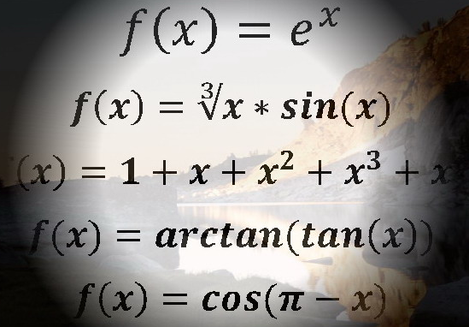
Declaring and Using Variables
var

Slide 40
Declaring Variables
When declaring a variable we:
Specify its name (called identifier)
May give it an initial value
The type is identified by the value
The syntax is the following:
Example:
var <identifier> [= <initialization>];
var height = 200;

Slide 41
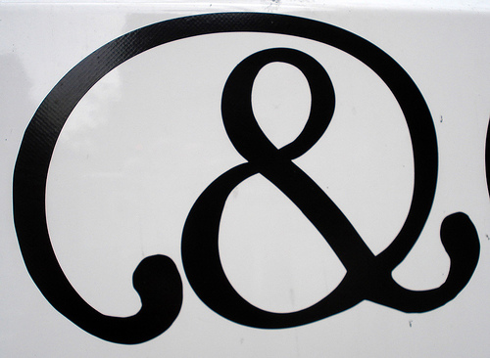
Identifiers
Identifiers may consist of:
Letters (Unicode)
Digits [0-9]
Underscore '_'
Dollar '$'
Identifiers
Can begin only with a letter, $, or an underscore
Cannot be a JavaScript keyword
Variables / functions names: use camelCase

Slide 42
Identifiers (2)
Identifiers
Should have a descriptive name
It is recommended to use only Latin letters
Should be neither too long nor too short
Names in JavaScript are case-sensitive
Small letters are considered different than the capital letters

Slide 43
Identifiers – Examples
Examples of correct identifiers:
Examples of incorrect identifiers:
var New = 2; // Here N is capital
var _2Pac; // This identifier begins with _
var поздрав = 'Hello'; // Unicode symbols used
// The following is more appropriate:
var greeting = 'Hello';
var n = 100; // Undescriptive
var numberOfClients = 100; // Descriptive
// Overdescriptive identifier:
var numberOfPrivateClientOfTheFirm = 100;
var new; // new is a keyword
var 2Pac; // Cannot begin with a digit

Slide 44
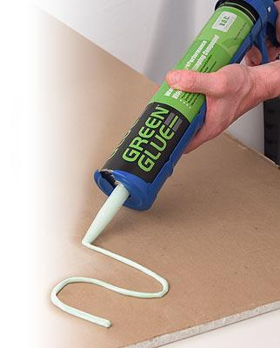

Assigning Values To Variables

Slide 45
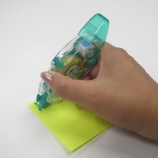
Assigning Values
Assigning values to variables
Is achieved by the = operator
The = operator has
Variable identifier on the left
Value on the right
Can be of any value type
Could be used in a cascade calling, where assigning is done from right to left

Slide 46

Assigning Values – Examples
Assigning values example:
var firstValue = 5;
var secondValue;
var thirdValue;
// Using an already declared variable:
secondValue = firstValue;
// The following cascade calling assigns
// 3 to firstValue and then firstValue
// to thirdValue, so both variables have
// the value 3 as a result:
thirdValue = firstValue = 3; // Avoid this!

Slide 47
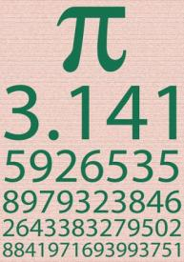
Initializing Variables
Initializing
Is assigning of initial value
Must be done before the variable is used!
Several ways of initializing:
By using a literal expression
By referring to an already initialized variable
Uninitialized variables are undefined

Slide 48
Initialization – Examples
Example of some initializations:
// This is how we use a literal expression:
var heightInMeters = 1.74;
// Here we use an already initialized variable:
var greeting = 'Hello World!';
var message = greeting;

Slide 49
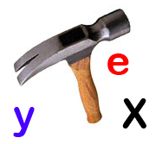

Assigning and Initializing Variables
Live Demo

Slide 50
Local and Global Variables
Local variables
Declared with the keyword var
Global variables
Declared without the keyword var
Bad practices – never do this!
var a = 5; // a is local in the current scope
a = 'alabala'; // the same a is referenced here
a = undefined;
a = 5; // the same as window.a = 5;

Slide 51
Data Types and Variables
http://academy.telerik.com

Slide 52
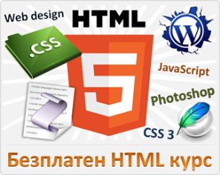



Free Trainings @ Telerik Academy
"Web Design with HTML 5, CSS 3 and JavaScript" course @ Telerik Academy
html5course.telerik.com
Telerik Software Academy
academy.telerik.com
Telerik Academy @ Facebook
facebook.com/TelerikAcademy
Telerik Software Academy Forums
forums.academy.telerik.com

